Slide 1

VIJAYA VITTALA INSTITUTE OF TECHNOLOGY Mini Project Presentation on
EXPERIMENTAL STUDY ON “AUTOMATIC TRAFFIC LIGHT CONTOLLER FOR EMERGENCY VEHICLE ”
UNDER THE GUIDANCE OF: PRESENTED BY:-
Mrs. Ashwini M A ALI AKBAR K (1VJ20EC001)
Asst. Prof. GOKUL KRISHNAN R (1VJ20EC004)
ECE Department,VVIT SIDDHARTH P (1VJ20EC010)
SAHADEV AMBANNAGOL (1VJ21EC400)

Slide 2
CONTENT
Introduction
Objective
Methodology
Components
Results
Conclusion
References

Slide 3
INTRODUCTION
Traffic Congestion is a serious issue in many densely populated cities. Especially during the passage of emergency vehicles in such congestions. This work mainly aims on providing a solution for the emergency faced by the ambulance during such traffic blocking. The implementation needs the usage of sound sensors and monitoring the ambulance to pass traffic signal lanes using Arduino. Fire disaster management prevention can also be the further application of sound detecting sensors.
Index Terms - sound detector, sensors, traffic congestion.

Slide 4
.
AUTOMATIC TRAFFIC LIGHT CONTOLLER FOR EMERGENCY VEHICLE
As the population of the modern cities is increasing, the vehicular travel is also increasing leading to congestion on roads. The average number of vehicles in India is growing at the rate of 10.16% annually, over the last few years. Spending hours in traffic jam has become part and parcel of metropolitan life style.
The traditional method for traffic control uses fixed traffic poles on the left side of the road at the traffic junctions that display the traffic light.
The steady increase in the number of automobiles on the road has amplified the importance of managing traffic flow efficiently to optimize utilization of existing road capacity. Presently major cities are covered under the surveillance of CCTV camera so that the vehicles and humans are tracked.

Slide 5
OBJECTIVES
Our proposed plan with this application is expected to go a long way in reducing the number of accidents.
Keeping the application always active can be more advantageous for tracking the movements of ambulance vehicles in traffic
Once an emergency vehicle is detected, the controller initiates a series of actions to optimize traffic flow.
It includes preemptively changing the traffic signal to green for the approaching emergency vehicle's direction, clearing the intersection of cross-traffic, and coordinating the signals at adjacent intersections to create a clear path.

Slide 6
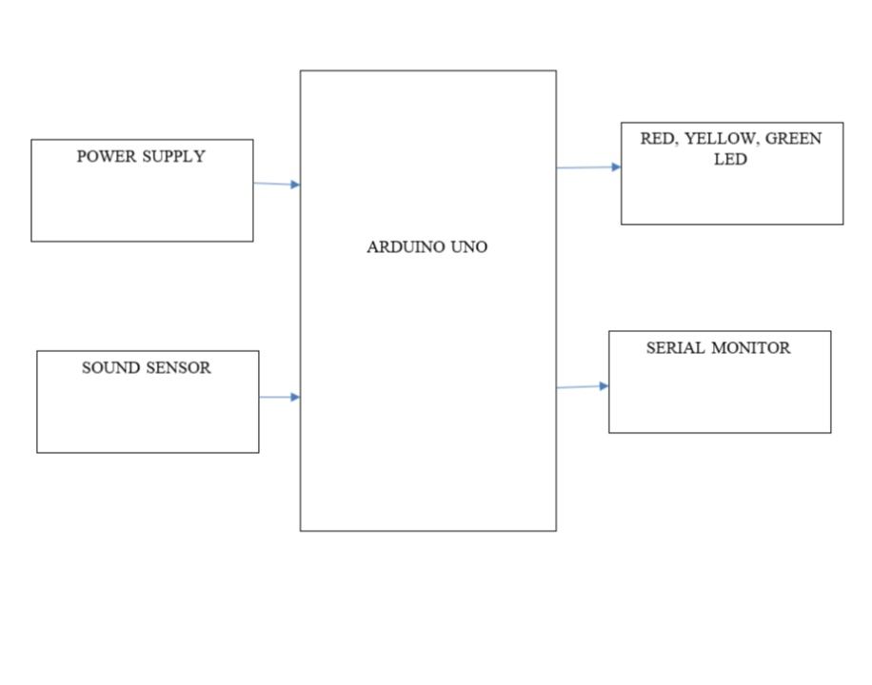
METHOLOGY

Slide 7
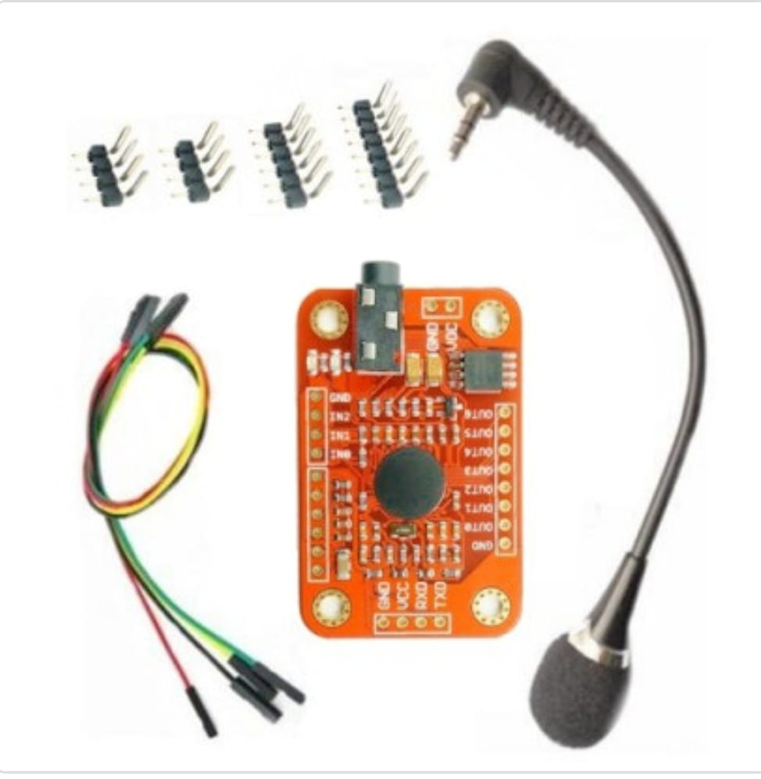
;
Fig : SPEECH RECOGNITION BOARD

Slide 8
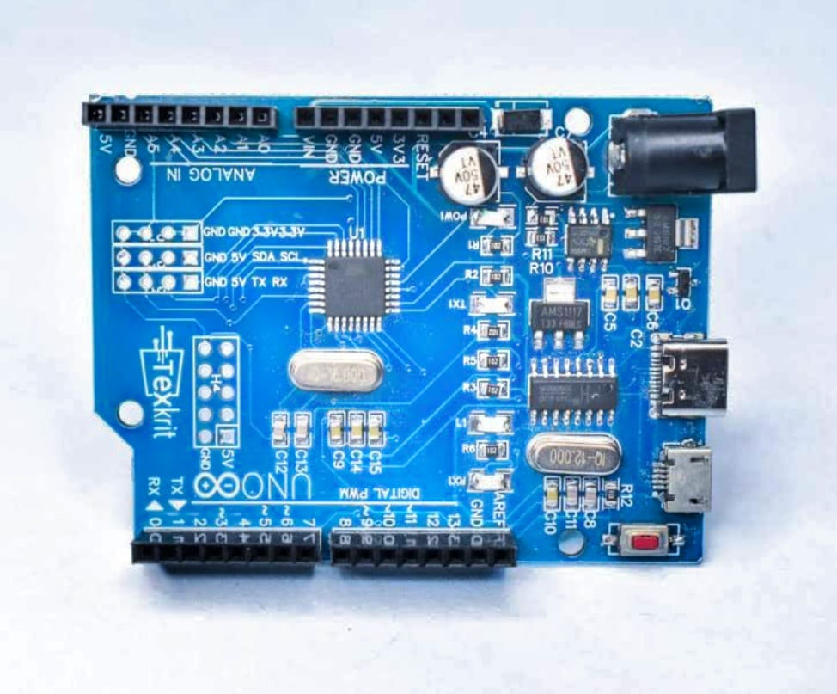
Fig : ARDUINO UNO BOARD

Slide 9
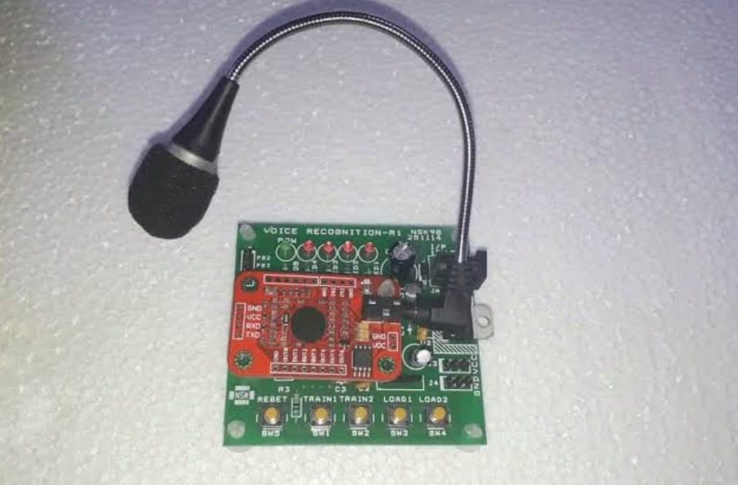
Fig : USB TO UART

Slide 10
WORKING OF AUTOMATIC TRAFFIC LIGHT CONTOLLER FOR EMERGENCY VEHICLE
1. Vehicle Detection: The system detection is done by sound recognition board which help to sample the input sound signal and match the previously stored signal in board, if it is match it will detect input sound signal and sent to Arduino UNO which helps to trigger traffic light.
2. Traffic Light Control Logic: Develop a traffic light control algorithm that can identify approaching emergency vehicles and give them priority while maintaining safety for emergency vehicle users. The algorithm should consider the location, speed, and direction of the emergency vehicle to determine the optimal control action.
3. Emergency Vehicle Authorization: Ensure that only authorized emergency vehicles lead to safety hazards. Unauthorized vehicles attempting to exploit the system could activate the priority control.

Slide 11
ADAVANTAGES AUTOMATIC TRAFFIC LIGHT CONTOLLER FOR EMERGENCY VEHICLE
● This innovative system uses various sensors, communication devices, and advanced algorithms to detect and prioritize emergency vehicles.
● This ensures smooth passage through intersections and reducing the risk of emergency accidents.
● The system can detect the approach of an ambulance through sound receiver or other tracking methods, and it communicates with the traffic light infrastructure to give the emergency vehicle a green light as it approaches Intersections.
● It enhances the efficiency and effectiveness of emergency services, ultimately improving public safety and saving lives.

Slide 12
APPLICATION OF AUTOMATIC TRAFFIC LIGHT CONTOLLER FOR EMERGENCY VEHICLE
This application is help to long way in reducing the number of emergency accidents.
The traffic light controller can detect the approach of an emergency vehicle and automatically change the signals and allowing the vehicle to pass through quickly and safely.
Traffic congestion can lead to cost savings for emergency services and the public.
This allows emergency services to communicate directly with the traffic light system.

Slide 13
CONCLUSION
With automatic traffic signal control based on the traffic density in the route, the manual effort on the part of the traffic policeman is saved. As the entire system is automated, it requires very less human intervention, the signal automatically turns to red, so that the police officer can take appropriate action, if he/she is present at the junction. Emergency vehicles like ambulance, fire trucks, need to reach their destinations at the earliest. If they spend a lot of time in traffic jams, precious lives of many people may be in danger. With emergency vehicle clearance, the traffic signal turns to green as long as the emergency vehicle is waiting in the traffic junction. The signal turns to red, only after the emergency vehicle passes through.
The system has been developed with much care that it is free of errors and at the same time it is efficient and less time consuming. The important thing is that the system is robust. Avoid malfunction from outsiders .It goes through all phases of software development cycle. So product is accurate. Also provision is provided for future developments in the system.

Slide 14
REFERENCES
G. Varaprasad and R. S. D. Wahidabanu, “Flexible routing algorithm for vehicular area networks,” in Proc. IEEE Conf. Intell. Transp. Syst.Telecommun., Osaka, Japan, 2010, pp. 30– 38.
B. P. Gokulan and D. Srinivasan, “Distributed geometric fuzzy multiagent urban traffic signal control,” IEEE Trans. Intell. Transp. Syst., vol. 11, no. 3, pp. 714–727, Sep. 2010.
K. Sridharamurthy, A. P. Govinda, J. D. Gopal, and G. Varaprasad, “Violation detection method for vehicular ad hoc networking,” Security Commun. Netw., to be published.
M. Abdoos, N. Mozayani, and A. L. C. Bazzan, “Traffic light control in non-stationary environments based on multi agent Q-learning,” in Proc.14th Int. IEEE Conf. Intell. Transp. Syst., Oct. 2011, pp. 580–1585.
ZigBee Specifications, ZigBee Alliance IEEE Standard 802.15.4k2013, 2014.
Traffic Congestion in Bangalore—A Rising Concern.

Slide 15
THANK
YOU

